Slide 1

Project: TA Report Web App
IE04 Weekly Progress Report, week 5
2023/11/22
Team: Pikachu

Slide 2
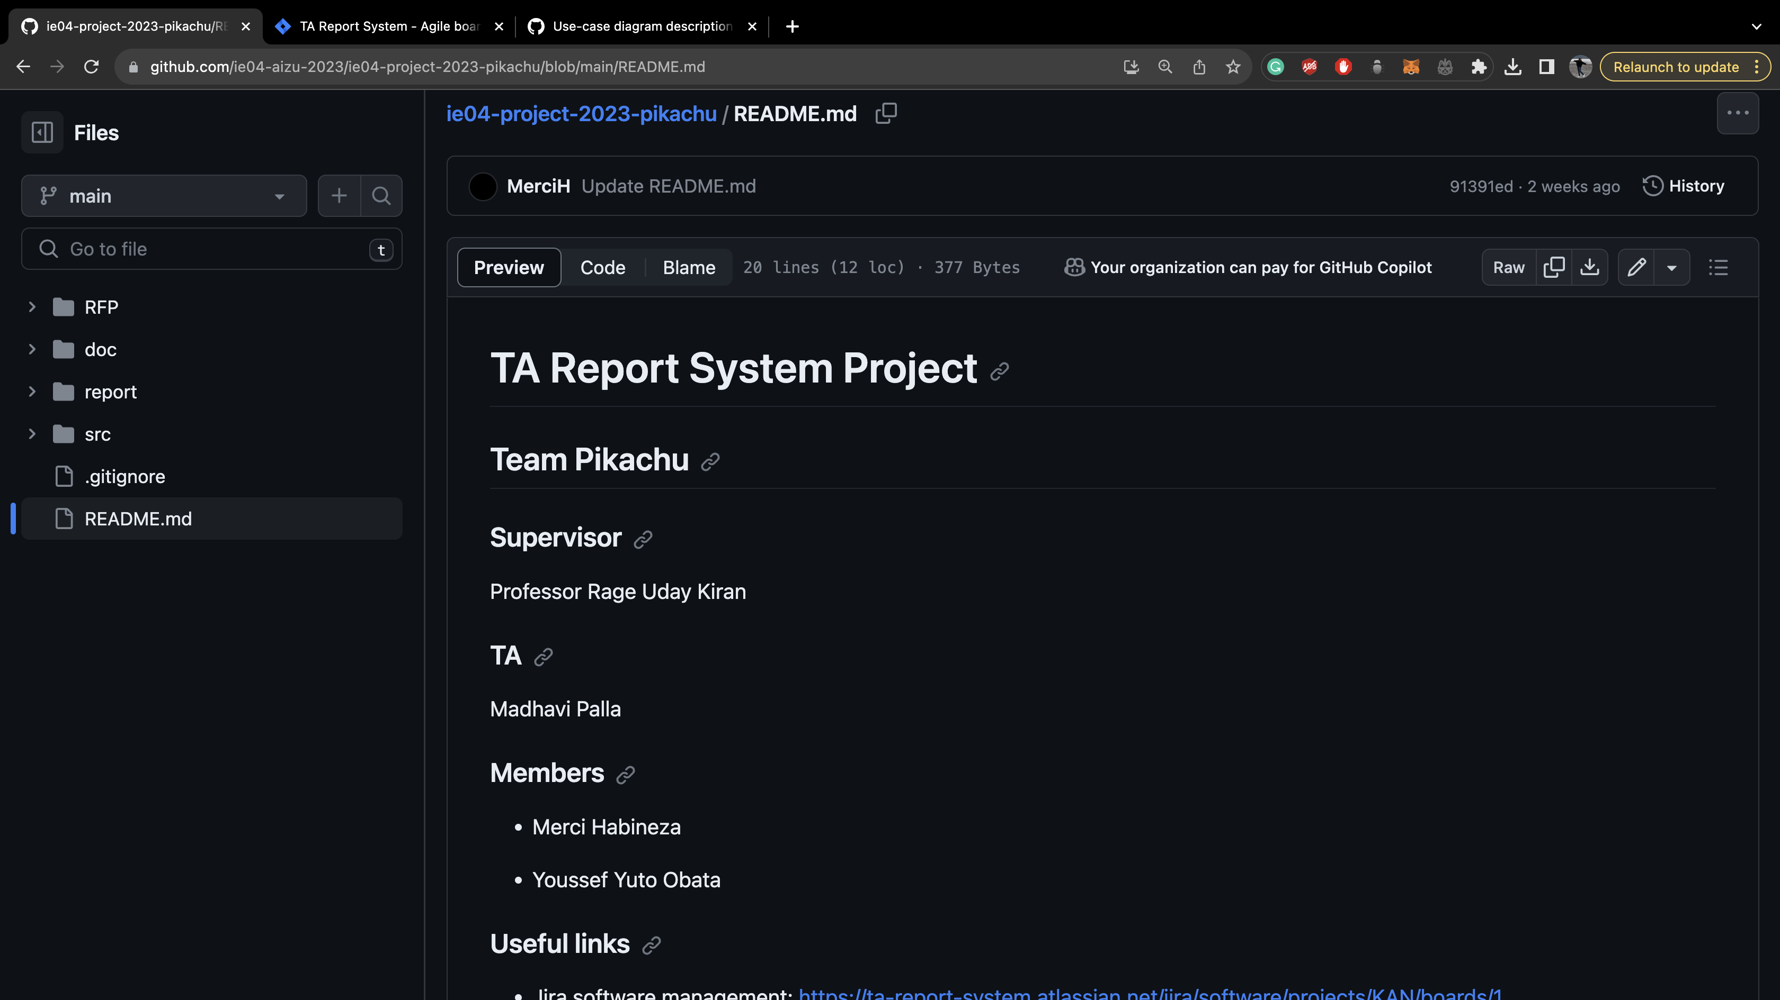

Slide 3
Activities of Previous Weeks
Task | Member | Work Hours
Sequence diagram | Merci | 0:30
(UI front-end) login screen | Youssef | 5:30
(UI front-end) TA course screen | Merci | 9:30
(UI front-end) TA report screen | Merci | 8:30
(UI front-end) Faculty screen | Youssef | 4:30
(UI front-end) Administration screen | Youssef | 8:30
(UI front-end) Notification Tab | Youssef | 0:30
 | Total time: | 40h:00

Slide 4
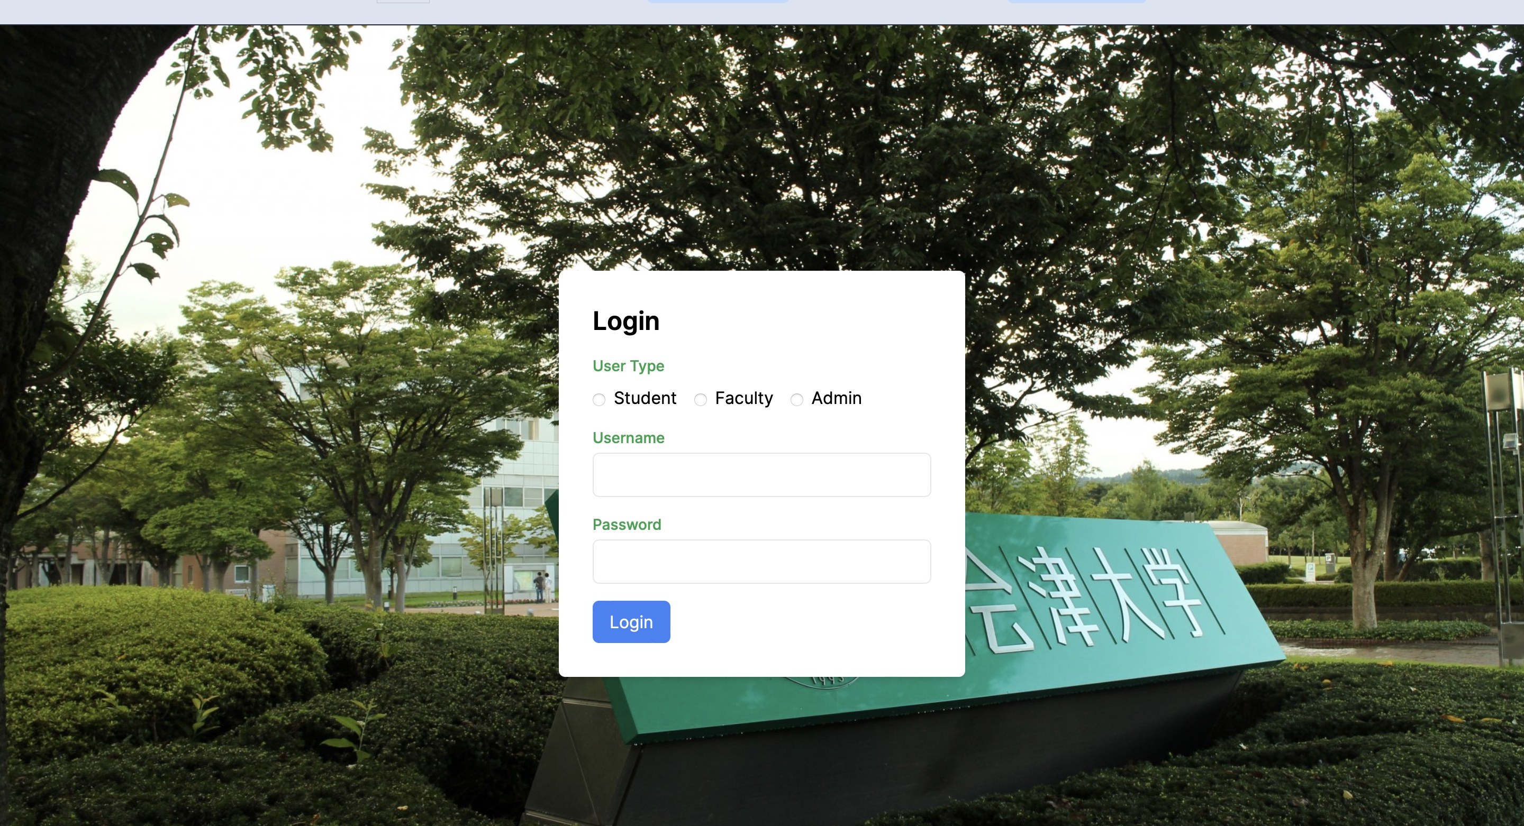
Login Screen

Slide 5
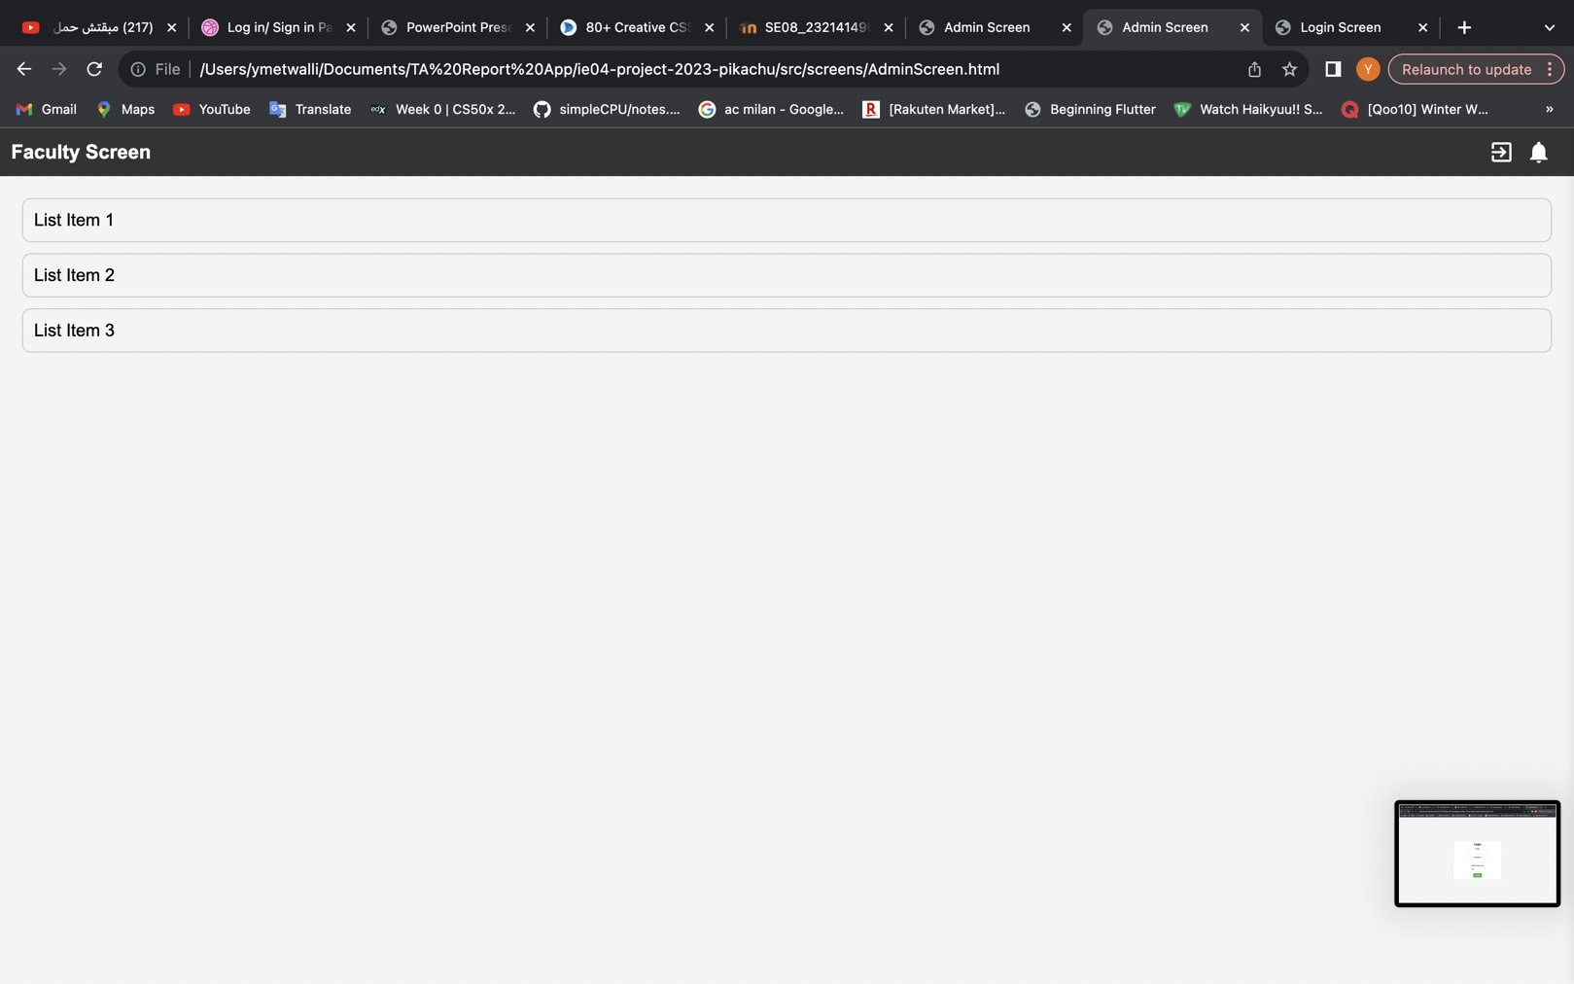

Slide 6
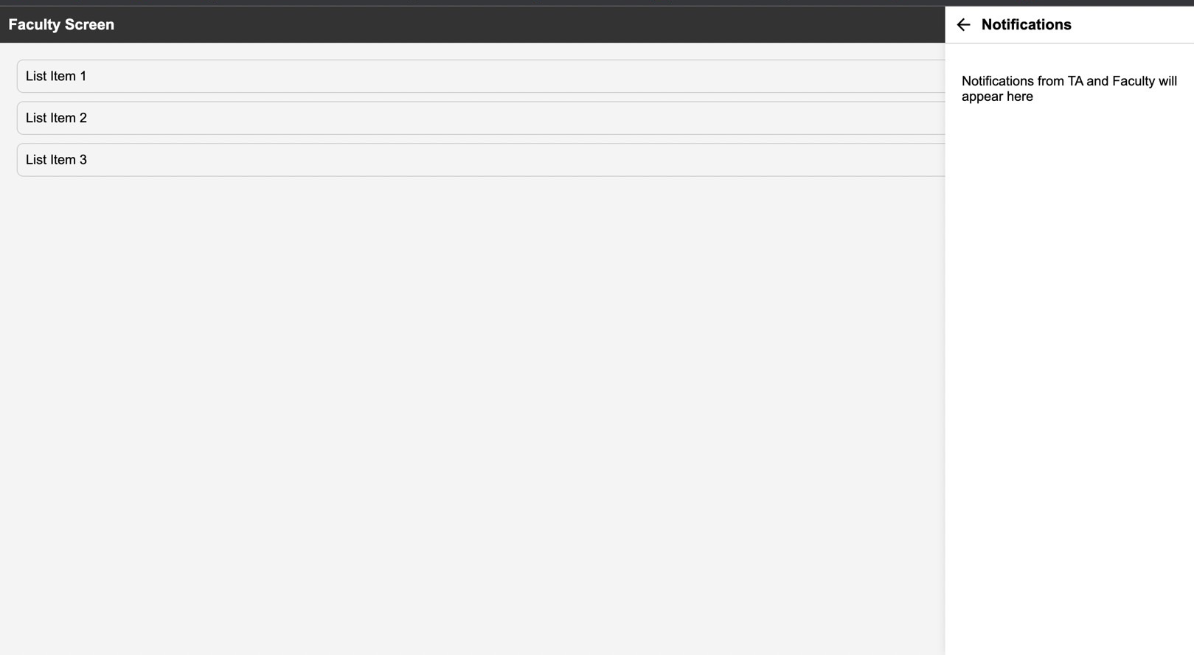
Notification Tab

Slide 7
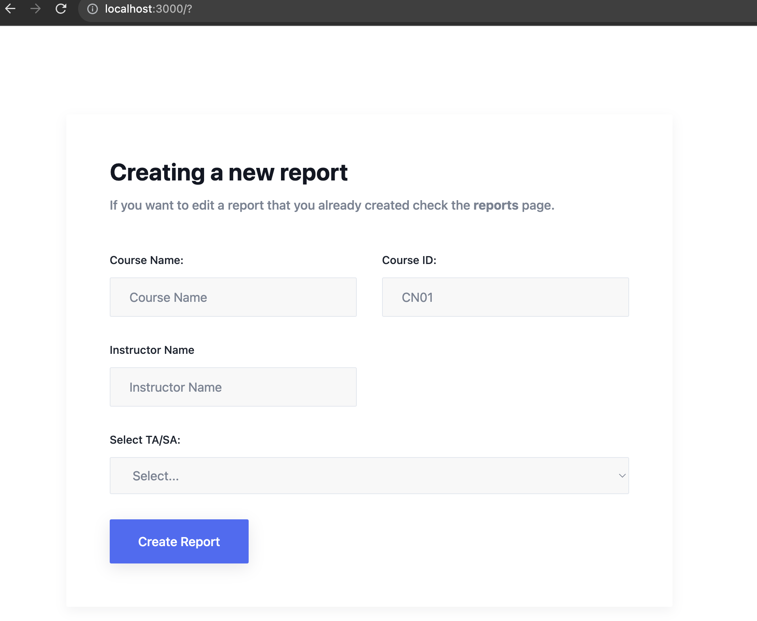
New Course Screen

Slide 8
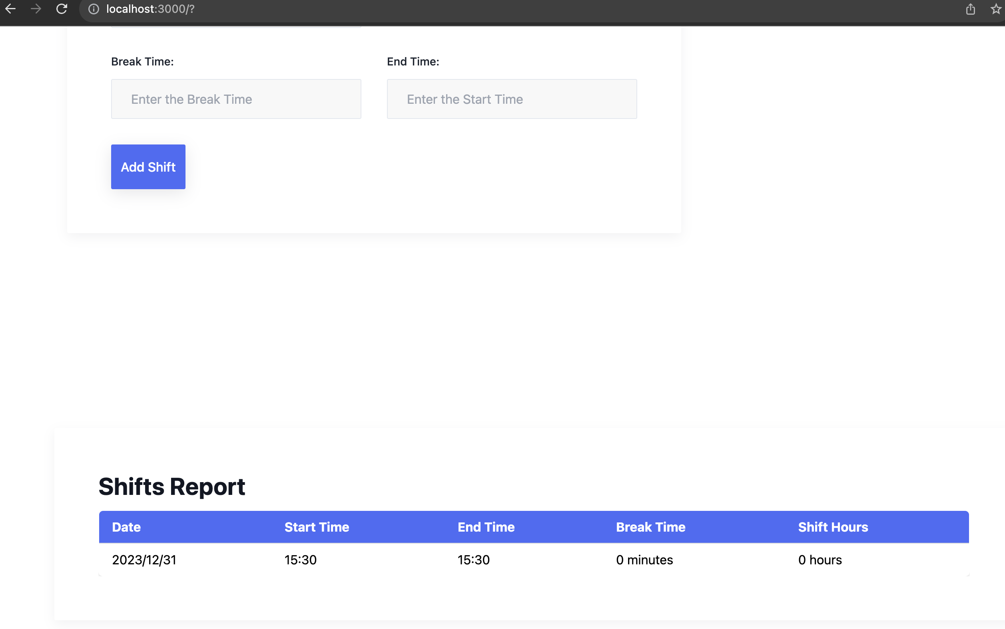
Report Screen

Slide 9
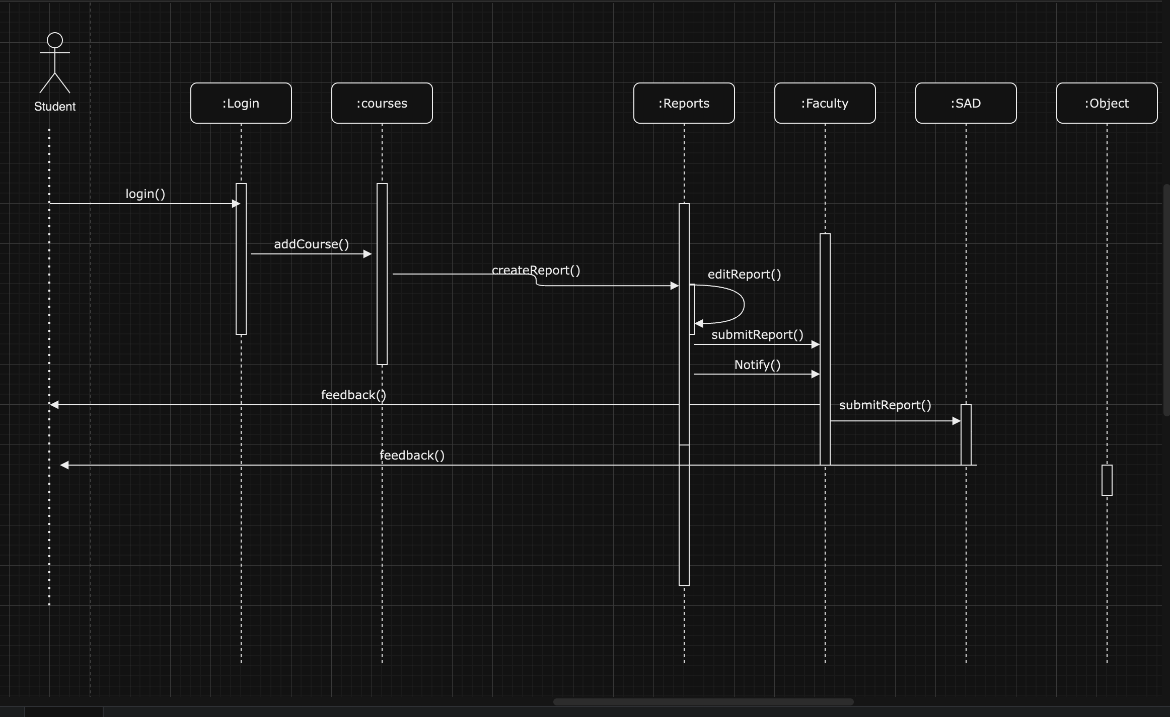
Sequeence Diagram

Slide 10
Plan for Next Week
Task | Member | Work Hours
Develop Database Logic | Youssef &Merci | 0:30
(Front-end) TA course screen | Merci | 0:30
(Front-end) TA report screen | Merci | 0:30
(Front-end) Faculty screen | Youssef | 0:30
(Front-end) Administration screen | Youssef
(Front-end) Notification Tab | Youssef | 0:30
 | Total time: | 00h:00

Slide 11
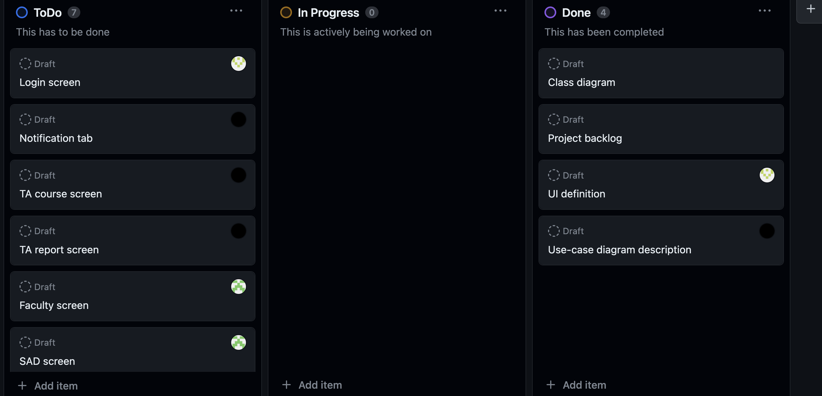
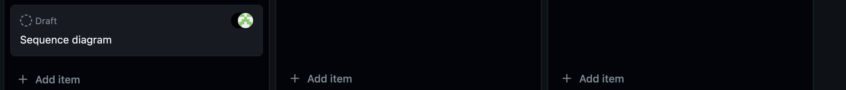
Phase Task Board

Slide 12
Issues & Risks (*if any)
Problem: navigating to faculty, student, admin screens (NextJS is not easy ☹)
Cause:
Possible Solution
Deadline

